Slide 1
Hidden Markov Model
Lecture – 7
Nafis Neehal, Lecturer, Department of CSE, DIU

Slide 2
CONTENTS
Markov Chain Model
Probability of a Sequence for a Given Markov Chain Model
Hidden Markov Model
- Forward Algorithm
- Viterbi Algorithm

Slide 3
1. Markov Chain Model
Design of a Markov Chain Model

Slide 4
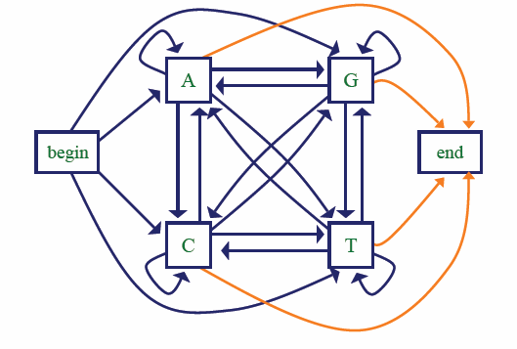
Markov Chain Model
A Markov Chain Model is defined by a set of states (A,C,G,T) and a set of transitions associated with those states.

Slide 5
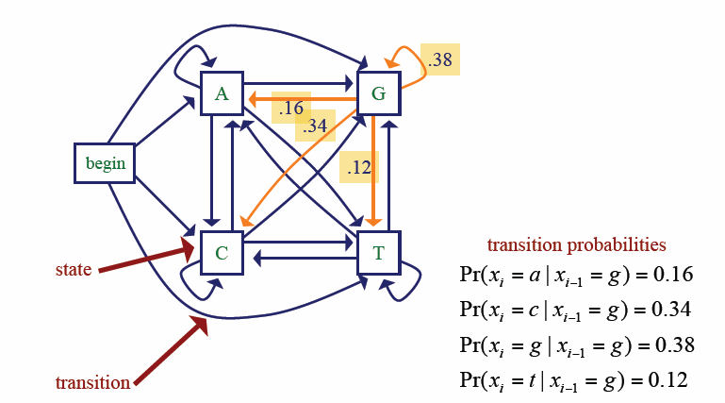
Markov Chain Model
Each and every transition from one site to another (A to G, C to A etc.) will occur with some transition probability (Will be given in Question as a Chart)
There will be given a specific probability value for each transition from ‘Begin’ to all other sites (Begin to A, Begin to C etc.)
If no transition value is given for Begin, then assign (1/4) = 0.25 to each of the transitions (Begin -> A, Begin -> C, Begin -> G, Begin -> T)
Same will be applicable for all transition to End (not shown in this picture, but shown in the previous slide’s picture)

Slide 6
2. Probability of a Sequence for a Given Markov Chain Model
Calculate the probability of a given sequence using Marcov Chain Model

Slide 7
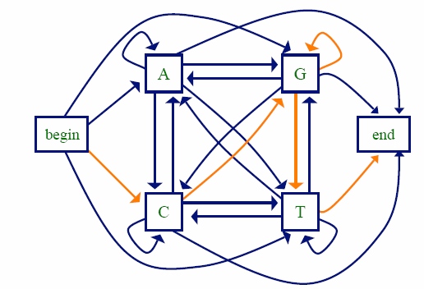
Calculate the Probability of a given sequence
P (C|A)
 | A | C | G | T
A | .18 | .27 | .43 | .12
C | .17 | .37 | .27 | .19
G | .16 | .34 | .38 | .12
T | .08 | .36 | .38 | .18
P(CGGT) = P(C | begin) P(G | C) P(G | G) P(T | G) P(end | T)
= 0.25 x 0.27 x 0.38 x 0.12 x 0.25
= 0.0007659

Slide 8
3. Hidden Markov Model
Concept, Algorithms

Slide 9
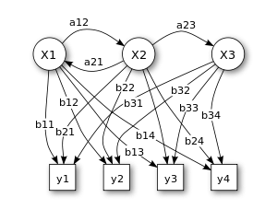
Hidden Markov Model
In Hidden Markov Model, appropriate origin of the outcome observed is hidden, only the outcome is emphasized.

Slide 10
Scenario: The Occassionally Dishonest Casino Problem
0.99
0.80
Emission Probabilities
A casino uses a fair die most of the time, but occasionally switches to a loaded one
Fair die: Prob(1) = Prob(2) = . . . = Prob(6) = 1/6
Loaded die: Prob(6) = ½ (Biased)
So, Prob(1) = Prob(2) = . . . = Prob(5) =
{ ( 1 - 1/2) }/5 = 1/10
1: 1/6
2: 1/6
3: 1/6
4: 1/6
5: 1/6
6: 1/6
1: 1/10
2: 1/10
3: 1/10
4: 1/10
5: 1/10
6: 1/2
0.01
0.2
Transition Probabilities
Prob(Fair -> Loaded) = 0.01
Prob(Loaded -> Fair) = 0.2
Transitions between states obey a Markov process
Probability Outcomes in Fair Dice
Probability Outcomes in Loaded Dice

Slide 11
Problem Statement for Forward Algorithm
For 3 Consecutive dice rolling, the outcome observed:
- 6 (first rolling outcome)
- 2 (second rolling outcome)
- 6 (third rolling outcome)
Now find out the probabilities for each possible combinations of two different types of dices (fair and loaded) which might have produced the outcome (6,2,6). Or how likely is if given a specific sequence?
Example: What is the probability that the consecutive outcomes (6,2,6) were generated from the dice combination (F,L,F), which means, the first dice was Fair and outcome was 6, Second dice was Loaded and outcome was 2 and the Last Dice was Fair and outcome was 6?

Slide 12
Forward Algorithm
Outcome = 6,2,6
Static Probability is always = 0.5
Prob (FFF) = Static Probability x Probability of outcome 6 in a Fair Dice x Transition Probability of Fair to Fair x Probability of outcome 2 in a Fair Dice x Transition Probability of Fair to Fair x Probability of outcome 2 in a Fair Dice
= 0.5 x 1/6 x 0.99 x 1/6 x 0.99 x 1/6
= 0.0027
Prob (FFL) = Static Probability x Probability of outcome 6 in a Fair Dice x Transition Probability of Fair to Fair x Probability of outcome 2 in a Fair Dice x Transition Probability of Fair to Loaded x Probability of outcome 6 in a Loaded Dice
= 0.5 x 1/6 x 0.99 x 1/6 x 0.01 x 1/2 = 0.0000682
Prob (FLF) = 0.5 x 1/6 x 0.01 x 1/10 x 0.2 x 1/6 = 0.0000275
Find all Prob (FLL), Prob (LFF), Prob (LFL), Prob (LLF) and Prob (LLL) in the same way. The combination which gives the MAXIMUM probability value will be the most likely combination which have produced the outcome 6,2,6.

Slide 13
Problem Statement for Viterbi Algorithm
For 3 Consecutive dice rolling, the outcome observed:
- 6 (first rolling outcome)
- 2 (second rolling outcome)
- 6 (third rolling outcome)
Now find out the most likely combination which produces this outcome directly (without finding all the combinations of fair and loaded dice like we did in Forward Algorithm)

Slide 14
Viterbi Algorithm
Outcome = 6,2,6
Static Probability is always = 0.5
Transition Probability
 | 6 | 2 | 6
Fair | (1/6)x(1/2) = 1/12 | (1/6) x max{(1/12) x 0.99, (1/4) x 0.2} = 0.01375 | (1/6) x max{0.01375 x 0.99, 0.02 x 0.2} = 0.00226875
Loaded | (1/2) x (1/2) = 1/4 | (1/10) x max{(1/12) x 0.01, (1/4) x 0.8} = 0.02 | (1/2) x max{0.01375 x 0.01, 0.02 x 0.8} = 0.08

Slide 15
Viterbi Algorithm (Final Result)
Outcome = 6,2,6
Static Probability is always = 0.5
Transition Probability
 | 6 | 2 | 6
Fair | (1/6)x(1/2) = 1/12 | (1/6) x max{(1/12) x 0.99, (1/4) x 0.2} = 0.01375 | (1/6) x max{0.01375 x 0.99, 0.02 x 0.2} = 0.00226875
Loaded | (1/2) x (1/2) = 1/4 | (1/10) x max{(1/12) x 0.01, (1/4) x 0.8} = 0.02 | (1/2) x max{0.01375 x 0.01, 0.02 x 0.8} = 0.08
Choose Maximum Value in Each Column, Start from Rightmost column up to Leftmost.
So, Final Result = LLL where L(First Dice) L(Second Dice) L(Third Dice) from left to right.

Slide 16
Interested?
TO BE CONTINUED

